Slide 1




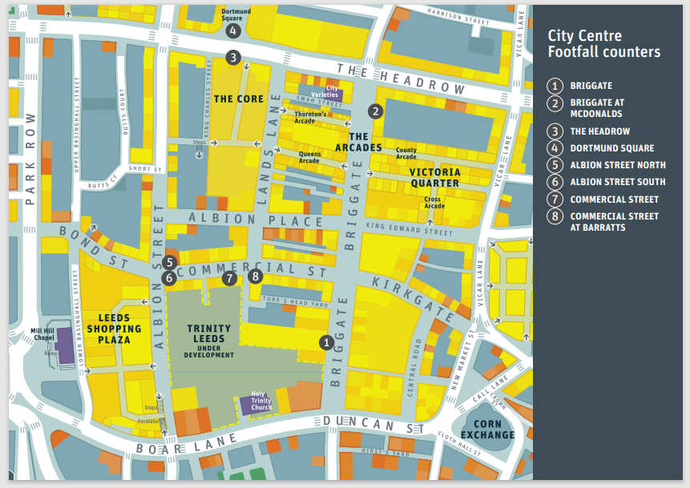
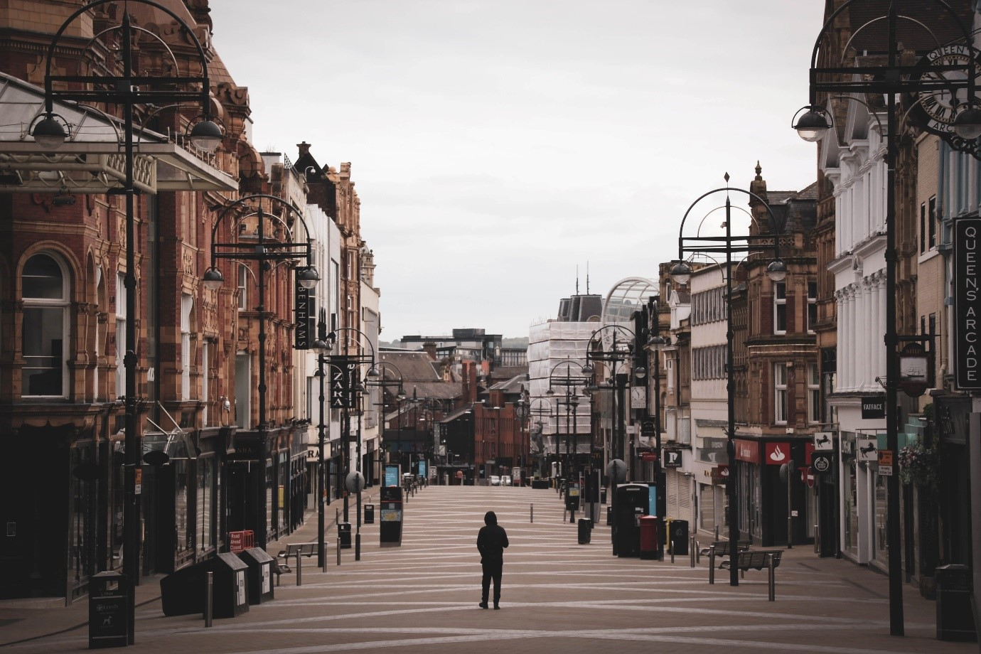
2008 – 2021
629,424 filtered hourly counts
Cleaned and Aggregated Data by City Council Ambient Pop under COVID-19 Project
Modelling Ambient Populations under Different Restriction Schemes
How have cities changed during the pandemic?
Which changes will remain as the pandemic subsides?
Raw Data From Data Mill North
Indumini Ranatunga | Dr Patricia Ternes Dallagnollo | Dr Victoria Houlden | Dr Nicolas Malleson

Slide 2
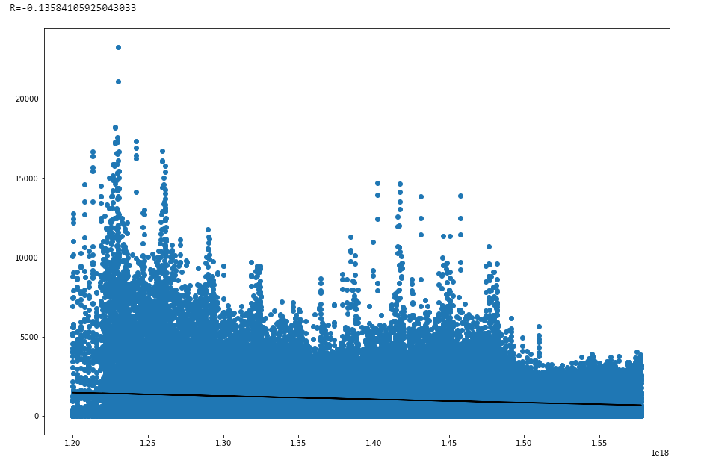
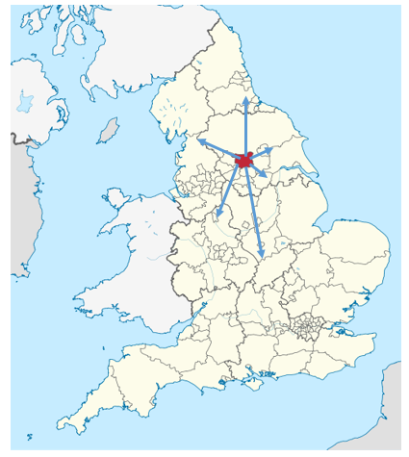

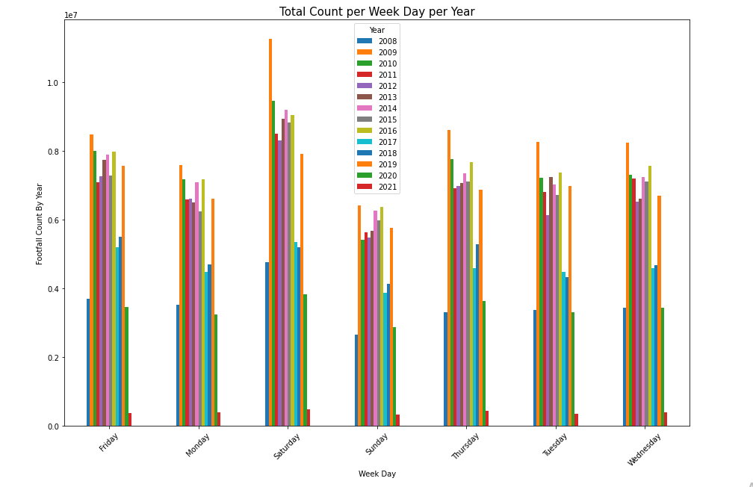
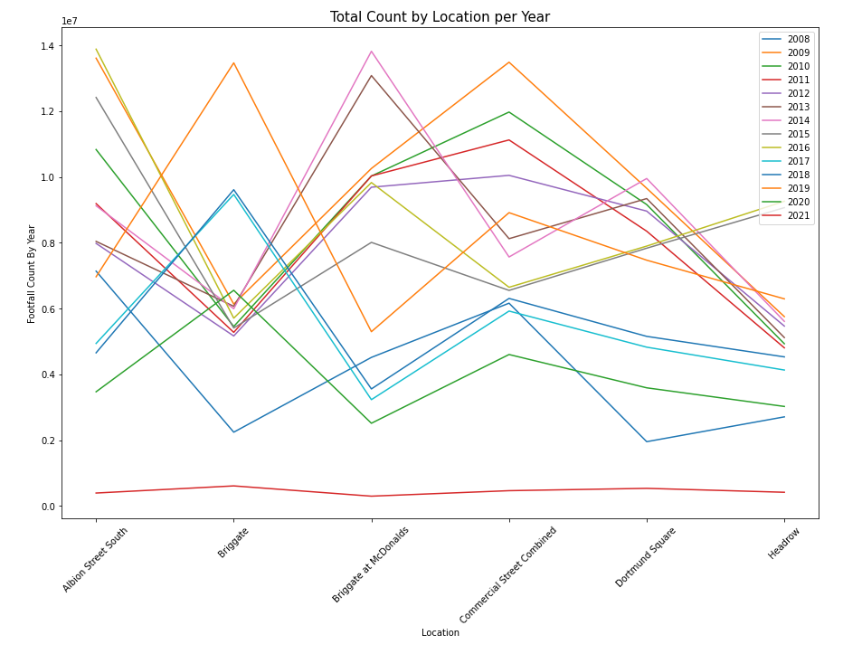
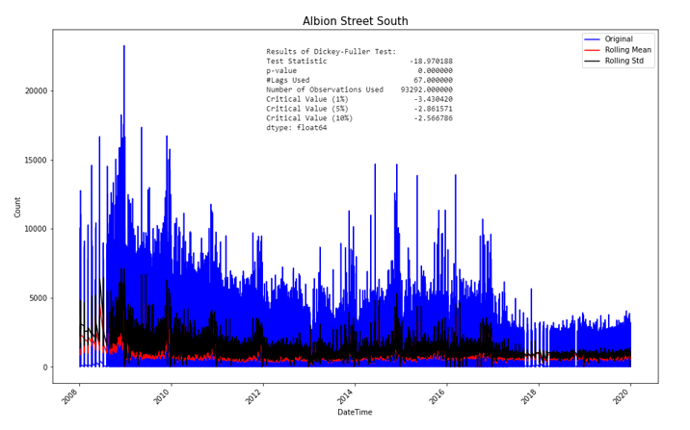

1/3 Exploratory Data Analysis (EDA)
2/3 Initial Time Series Analysis
3/3 Next Steps
SARIMA
ARIMA
Etc.
Thank you…
Indumini Ranatunga | Dr Patricia Ternes Dallagnollo | Dr Victoria Houlden | Dr Nicolas Malleson

